Slide 1
Fast Neutron Reactors
A look at the History and current research of Fast Reactor Design
Kevin Fischer || Alex Hagen || Neal Kostry

Slide 2
Introduction
- Introduction to Fast Neutron Reactors
- History of Fast Neutron Reactors
- Technical Specifications
- Applications and Future Uses

Slide 3
Fast Neutron Reactors
What is the purpose of a fast neutron reactor?
Fast Neutron Reactors are designed to improve the performance of conventional reactors by utilizing only fast neutrons as a means of initiating fission.
What is the basic concept of operation?
Fast Neutron Reactors utilize uranium much more efficiently due to the production of fissile plutonium isotopes. This allows for the possibility to produce more fuel than is consumed, allowing for fuel “breeding”.

Slide 4
History of Fast Reactors

Slide 5
Overview
Fast Neutron Reactors began operation in the early 1950s, and have been operating ever since.
There are over 20 Fast Neutron Reactors worldwide.
There are over 400 reactor years worth of operator experience using Fast Neutron Reactors.
- General purpose of fast reactors are experimental, demonstrational or commercial.

Slide 6
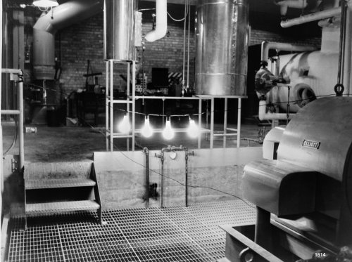
First EVER FAST Reactor (EBR-1)
EBR-1 (Experimental Breeder Reactor) was the first ever reactor to harvest energy from a nuclear reaction, located at Idaho National Lab.
In December of 1951, EBR-I produced enough electricity to power four 200 watt light bulbs.

Slide 7
Other Fast Reactors in USA
EBR-II – demonstration reactor run from 1963-1964 to show that a fast reactor can act as a fast or breeder reactor.
Fermi-I – first commercial fast neutron reactor. Located in Michigan and supplied only 66 MWe. Shutdown after only three years due to overheating.
- FFTF (Fast Flux Test Facility) – largest fast reactor in the United States and used for research. Located in Hanford, WA and supplied 400 MWe before shutting down in 1993.

Slide 8
Fast Reactors Worldwide
- Fast neutron reactors have operated in many countries worldwide, including the United Kingdom, France, Germany, India, Japan, Kazakhstan, Russia, and China.
Some of the more famous of these reactors include the Superphenix in France and the BN-600 in Russia.
The Superphenix was built to be the largest fast reactor in the world, supplying 1250 MWe. However, the reactor was shut down for political reasons in 1998.
BN-600 is a fast breeder reactor that is considered to be the most successful reactor built in Russia. It has supplied a constant supply of 600 MWe since 1980.

Slide 9
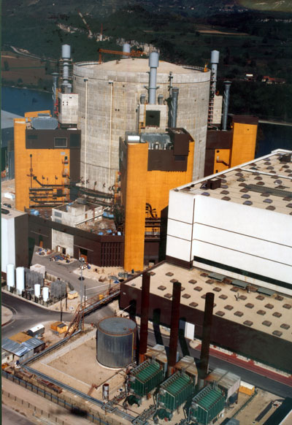
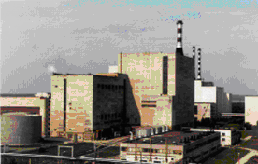
Fast Reactors Worldwide (Cont.)
Superphenix (France)
BN-600 (Russia)

Slide 10
Technical Specifications

Slide 11
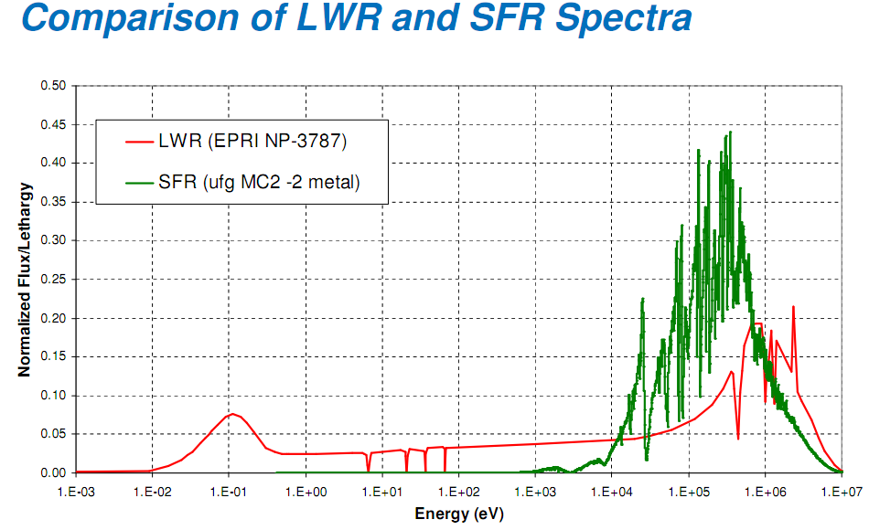
Fuel Design and Moderator
Spectra causes need for different fuel, coolant, building materials
Few Thermal Neutrons
No Moderation Needed
Resonances in Fast region Important
Fast Neutrons causes need for geometric change
Fast neutrons have longer range
Leakage will be higher
Leakage > Res Absorption
Causes large design shift away from moderation

Slide 12
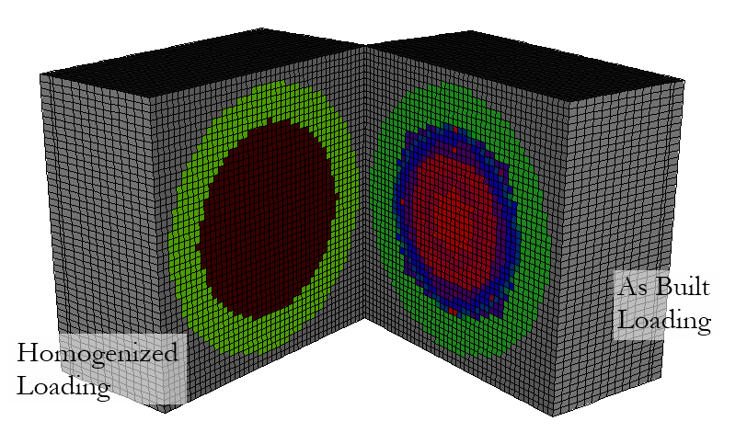
Reactor Design (Research)

Slide 13
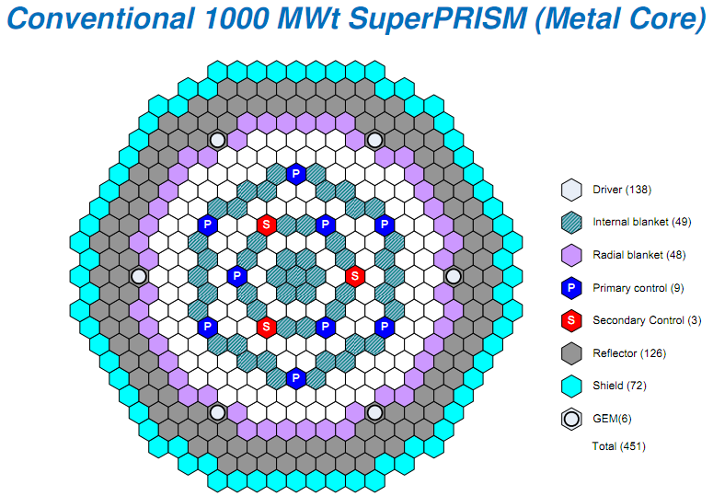
Reactor Design (Power)

Slide 14
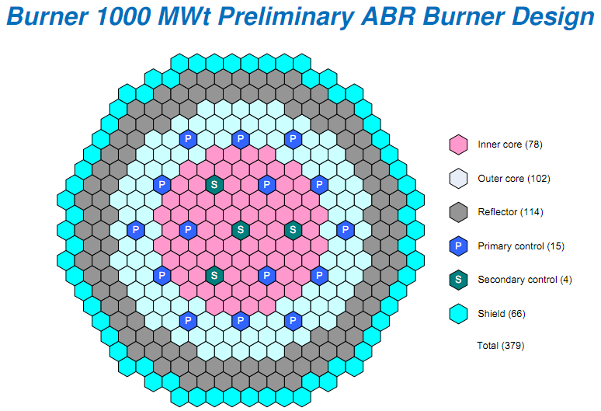
Reactor Design (Power)

Slide 15
Optimization Considerations
Little to No Moderation
Slowing Down Power ~1% of LWR Slowing Down Power
Sodium Coolant used despite physical difficulties for less moderation
Oxide fuels provide moderation even though better thermal properties
Resonance Absorptions within non-fissile materials
Pu vs. U Fuels (ZPPR21)
Reflectors
Borated Shield, Outer Blanket, (Depleted U) Reflector

Slide 16
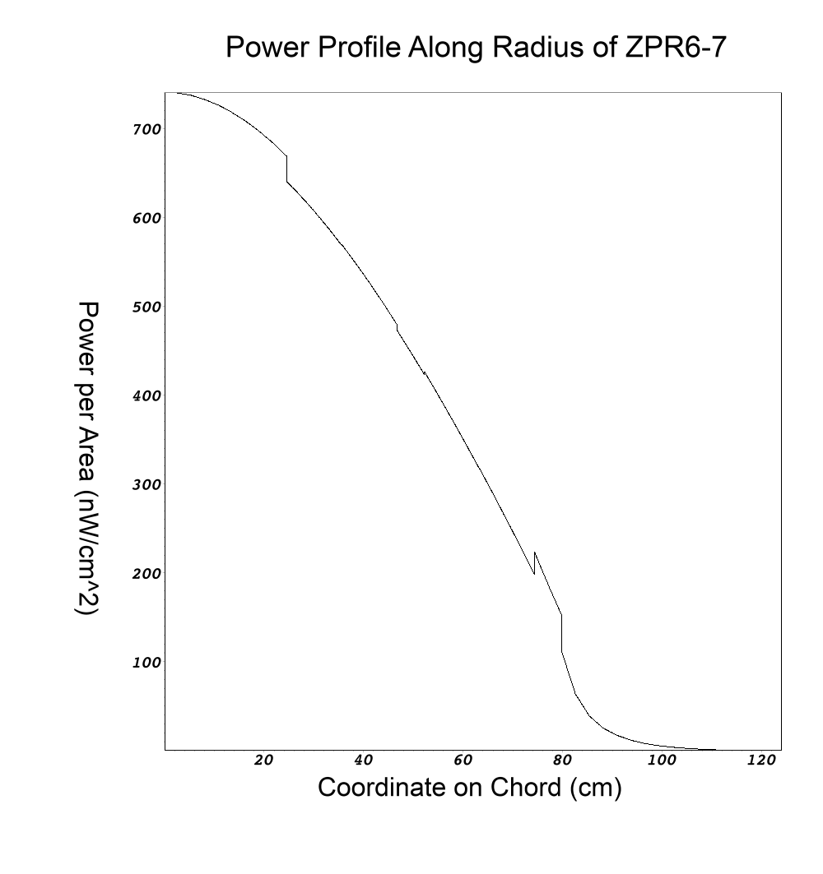
Power Profiles (No Control Rods)
Cosine (at criticality) function within core
Immediate dropoff at borated shield
Fast decrease through blanket
Increase at reflector, same rate decrease,
Dropoff to zero during gap region, protection of operating facility
NO CONTROL RODS IN MODEL

Slide 17
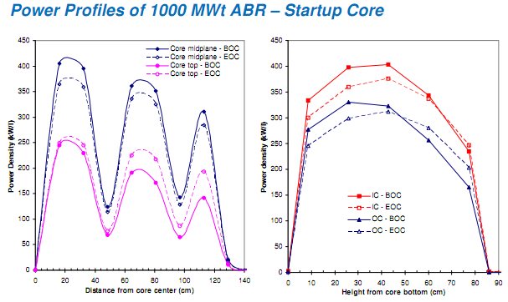
Power Profiles (Power Reactor)

Slide 18
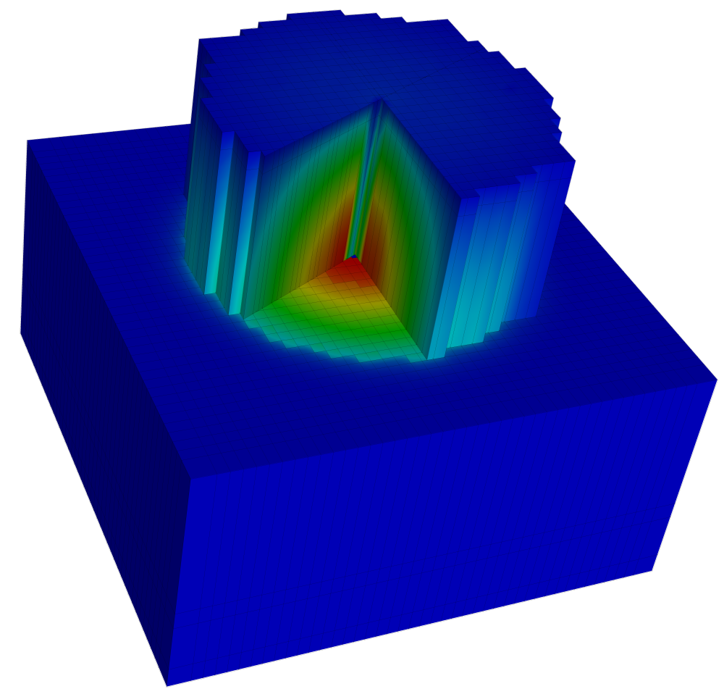
Power Profiles (3-D Research)
3-D Cutaway of ZPR6-7 Reactor
Gap Material (Blue) has been removed from top half
Cutaway into core shows color map of power distribution in 3 dimensions
Fission chamber in center (shows low power in chamber)
NO CONTROL RODS IN MODEL

Slide 19
Applications and Designs

Slide 20
Fast Reactor Benefits
Fuel Utilization
Hydrogen Production
Desalination
Thermal Efficiency
Passive Safety Systems

Slide 21
Fuel Benefits
Current Fuel Cycles are Open-Type
“Once Through” Cycles
Spent Fuel is left Unused
High Actinide Production Leads to long lived “hot” waste
Even with MOX Fuels, Still long term waste problems
Fuel Repositories are reaching their limits
Fast Reactors to use Thermal Reactor Spent Fuel
Burn Produced Actinides
Reduce Proliferation threat – closed fuel cycle burns Pu
Significantly Reduce wasted fuel

Slide 22
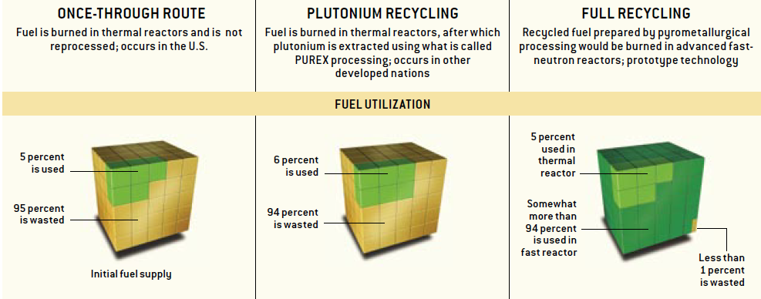
Fuel Benefits (cont’d)
From Dec. 2005 SciAm - Smarter Use of Nuclear Waste

Slide 23
Desalination and Hydrogen Production
Desalination
Location of Plants
Relatively low temperatures needed
Hydrogen Production
More economically feasible as temperature increases
Technologies on Fuel Cells and Electrolysis (Hydrogen Economy)

Slide 24
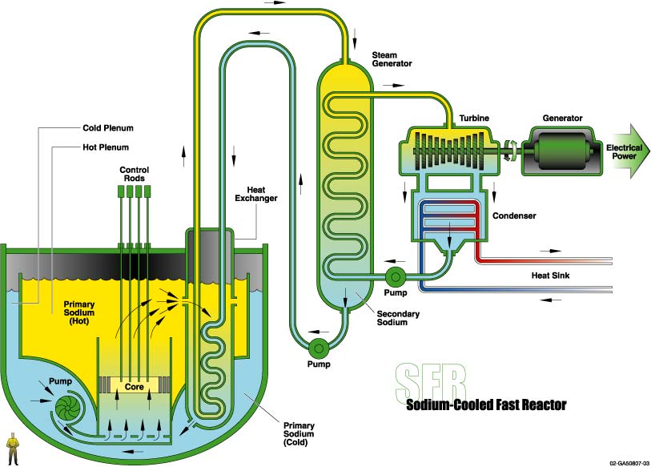
Proposed Reactors
Sodium Cooled Fast Reactor
Designed to burn high level waste from LWR’s
Operates around 550 °C
Uses 2 Loops of Liquid Sodium as Coolant
Advantages
Low Pressure Reactor
Closed Fuel cycle
3 different power designs
Prototypes have been built

Slide 25
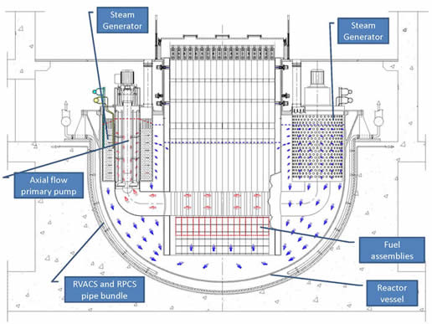
Proposed Reactors (cont’D)
Lead Cooled Fast Reactor
Very long operating cycles (~20 years)
Removable core
Nitride or Metallic Fuel
Advantages
High Operating Efficiencies
Negative reactivity feedback
Low Pressure and Non-reactive with air
Retains fission products well

Slide 26
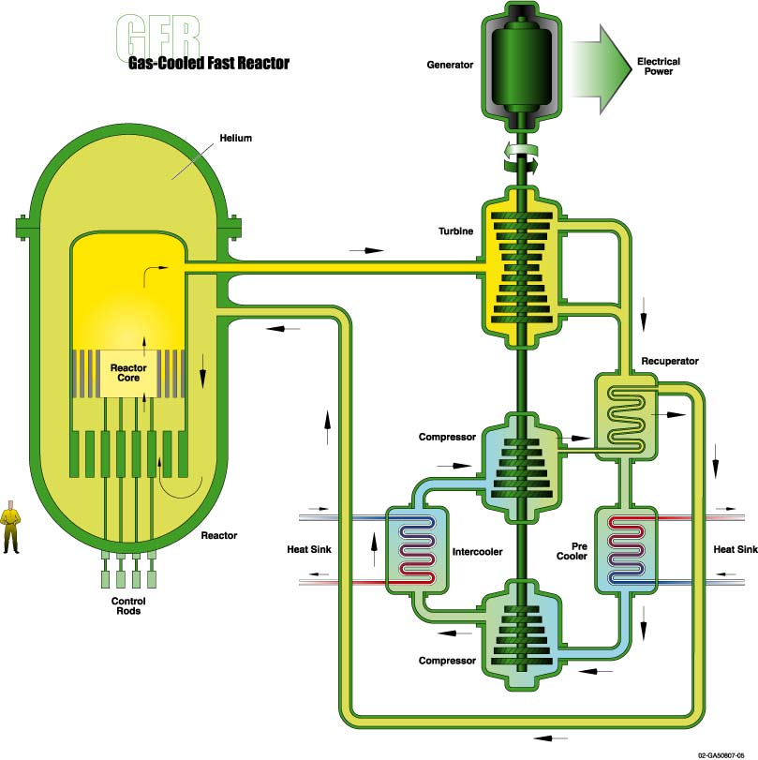
Proposed Reactors (cont’D)
Gas Cooled Fast Reactor
Helium Cooled Core with Direct Brayton
Operating Temperature at 850 deg C
Fuel either Composite Ceramic or new advanced design
Assemblies are plate or prismatic in design
Advantages
Easier Hydrogen production
Very High Efficiencies

Slide 27
Limitations and Future Research
Sodium Cooled Fast Reactor
Sodium-Water Interactions and Safety Analysis
Lead Cooled Fast Reactor
Corrosion in Lead can cause equipment malfunction
Current Temperature limit is around 450 deg C
Gas Cooled Fast Reactor
Materials Issues at 850 deg C
Low heat transfer coefficient
Safety Concerns for rapid depressurization

Slide 28
Questions?

Slide 29
References
Works Cited
Cinotti L., et al., “The ELSY Project”, Paper 377, Proceeding of the International Conference on the Physics of Reactors (PHYSOR), Interlaken, Switzerland, 14-19 September, 2008.
Department of Energy. (2004). Nuclear Hydrogen R&D Plan. District of Columbia: United States Department of Energy.
Generation IV International Forum. (2007). The Sodium-Cooled Fast Reactor. Retrieved November 10, 2011, from Generation IV Technology: http://www.gen-4.org/Technology/systems/sfr.htm
Hannum, W. H., Marsh, G. E., & Stanford, G. S. (2005, December). Smarter Use of Nuclear Waste. Scientific American .
Hill, D. (2006). Global Nuclear Energy Partnership Technology Demonstration Program. Nuclear Physics Conference (pp. 1-14). Idaho National Lab.
Hill, R. N. (2007). NRC Topical Seminar on Sodium Fast Reactors. Fast Reactor Physics. Two White Flint: Argonne National Lab.
US Department of Energy. (2010, December). Generation IV Nuclear Reactors. Retrieved 10 25, 2011, from World Nuclear Organization: http://world-nuclear.org/info/inf77.html

